Slide 1
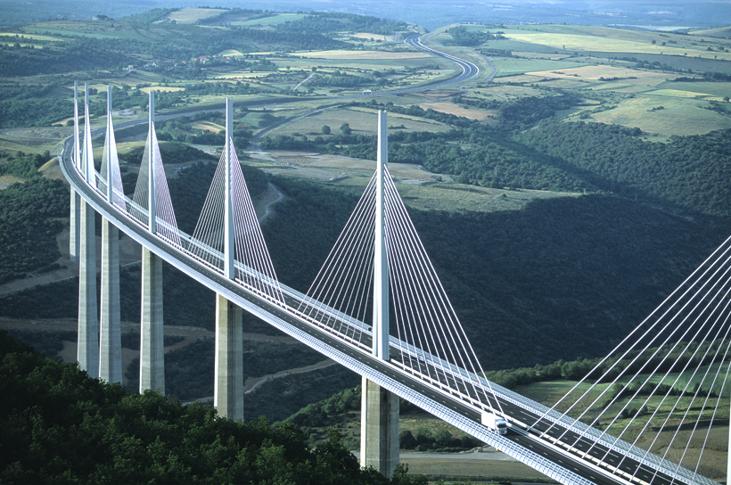
Bridge to Algebra

Slide 2

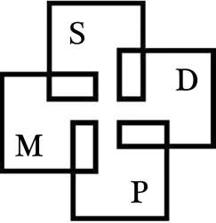

Preparing for Success in Algebra
English Language Learners in Mathematics
A Collaboration between:
Los Angeles USD
University of California, San Diego
San Diego State University
University of California, Irvine

Slide 3
Ivan’s Spending Spree
Ivan went to a store and spent 1/3 of his money on a book. He then went ahead and spent 2/5 of his remaining money on a computer game. After that, he spent 1/4 of his remaining money on a CD. Finally, he spent 1/6 of the remaining money on a candy bar leaving him with $15. How much money did he have originally?

Slide 4
History of Singapore Math
A nation that took the NCTM Standards and other research on problem-based approaches seriously is Singapore. After its independence in 1965, Singapore realized that without any natural resources it would have to rely on human capital for success, so they embarked on an effort to develop a highly educated citizenry. Various education reforms were initiated and in 1980 the Curriculum Development Institute was established, which developed the Primary Mathematics program. This program was based on the concrete, pictorial, abstract approach. This approach, founded on the work of renowned cognitive American psychologist Jerome Bruner, encourages mathematical problem solving, thinking and communication.

Slide 5
Key characteristics of K-8 Singapore math textbooks.
Topics emphasized are consistent with the NCTM Focal Points and the new Common Core Standards
Depth emphasized over breadth
More time is spent on each topic
Fewer topics are covered in a year.
Greater focus on mastery.

Slide 6
Key characteristics of the K-8 Singapore Math Curriculum.
Problem Solving Emphasis: Model drawing diagrams are used to promote understanding of word problems and provide a bridge to algebraic thinking.
More Multi-Step Problems: Problems often require the use of several concepts.
Mental Math: Techniques encourage understanding of mathematical properties and promote numerical fluency.

Slide 8
MENTAL MATH
Emphasizes an understanding of place value and the distributive, commutative and associative properties

Slide 9
Examples
Multiplication facts
7 x 6 = (5 x 6) + (2 x 6)
8 x 6 = 2 x (4 x 6)
9 x 6 = (10 x 6) – (1 x 6)

Slide 10
PROBLEM SOLVING WITH MODEL DRAWING
The model drawing approach takes students from the concrete to the abstract stage via an intermediate pictorial stage.
Students create bars and break them down into “units.” The units create a bridge to the concept of an “unknown” quantity that must be found.
In the Singapore approach, this strategy is introduced in the primary grades and the practice is continued through the middle grades.

Slide 11
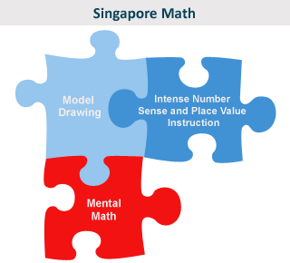
The Pieces Fit Together

Slide 12
Number sense is the overall understanding of a number. Mental math aids in the development of number sense.
Place Value is a student’s understanding of a digit’s position in a number.
Model Drawing is a seven-step visual method of turning a word problem into a diagram with unit bars that represent values.

Slide 13
PROBLEM SOLVING WITH MODEL DRAWING
The model drawing approach takes students from the concrete to the abstract stage via an intermediate pictorial stage.
Students create bars and break them down into “units.” The units create a bridge to the concept of an “unknown” quantity that must be found.
The language connection is emphasized as students finish the problem with a complete sentence giving their conclusion.

Slide 14
Seven Steps for Model Drawing
Read the problem. Identify the variables (the who and the what).. Draw a unit bar or bars. Chunk information by rereading the problem one sentence at a time, and adjust the unit bar or bars to match the information. Decide on your question mark, and draw it in the appropriate place. Work the computation. Write a complete and grammatically correct sentence to answer your question mark.

Slide 15
An 8 step slight variation
An 8 step procedure might have as step 2 after reading the problem, write out step 7 i.e. the complete sentence with a blank for the (yet uncalculated) answer. This helps to determine where the question mark is placed after the information is ‘chunked’.

Slide 16
Step 1 - Read The Problem
Mr. Hobart sells 6 pans of brownies every day. He makes $10 per pan. How much money does Mr. Hobart make in a day?
We can write a problem on the board and ask the whole class to read it in chorus.
We can ask each student to copy a problem from the board and read it to himself or herself silently.
We can ask each student to read the problem from his or her own paper in a low voice.
We can read a problem to students.

Slide 17
Step 1 - Read The Problem
Mr. Hobart sells 6 pans of brownies and 3 bags of chocolate cookies every day. He makes $10 per pan of brownies and $7 for each bag of cookies. How much money does Mr. Hobart make in a day?

Slide 18
Step 2 Identify the Variables
Who does or has what? How does that relate to what the other person or people do or have?
Mr. Hobart sells 6 pans of brownies and 3 bags of cookies every day . He makes $10 per pan. How much money does Mr. Hobart make in a day?
Mr Hobart sells both brownies and cookies every day.
How much money does he make each day?

Slide 19
Step 3 Drawing Unit Bars
Unit bars provide the visual. In early grades, students can draw individual units, like fish, for unit bars . We would like students to draw squares or rectangles of the same size for each unit bar.
Mr Hobart’s brownies
Mr Hobart’s Cookies

Slide 20
Step 4 Reread Each Sentence and Adjust Unit Bars
Chunk information to make it more manageable
Adjust the unit bar or bars to match the information in the problem.
This is where it is easy to make a mistake, work slowly.
Mr. Hobart sells 6 pans of brownies every day. He makes $10 per pan. How much money does Mr. Hobart make in a day?

Slide 21
Step 4 Continued
The first sentence tells us he sold 6 pans of brownies and 3 bags of cookies every day.
The next sentence tells us he makes $10 per pan and $7 per bag of cookies.
$10
$10
$10
$10
$10
$10
Brownies
$7
$7
$7
Cookies
You may want to write appropriate quantities either right above or below the bars in grades 3 and up. You can write inside the bars in lower grades.

Slide 22
Step 5 - Set the Question Mark
$10
$10
$10
$10
$10
$10
Money from brownies
$7
$7
$7
?
Money from Cookies
We are interested in the total amount of money he makes
from selling brownies and cookies

Slide 23
Step 6 – Do the Computation
$10
$10
$10
$10
$10
$10
Money from brownies
$7
$7
$7
?
Money from Cookies
One unit of brownies sells for $10., 10 times 6 = 60
One unit of cookies sells for $7. , 3 times 7 is 21
60 + 21 = 81.

Slide 24
Step 7 Write a Sentence
The sentence has to be complete.
The sentence should address the who and the what and the question mark.
Mr. Hobart sells 6 pans of brownies and 3 bags of cookies each day
and makes $81 per day.

Slide 25
Model Examples
Bill has 7 cookies. He eats 4 cookies. How many cookies remain?
Cookies
?
4
7

Slide 26
Maria has 10 cookies. Bill has 3 cookies. How many more cookies than Bill does Maria have?
Bill
Maria
3
?
10

Slide 27
Gretchen has $10. Rafa has $2 more than Gretchen. How much do they have altogether?
$10
Gretchen
?
$2
Rafa

Slide 28
Example : The sum of two numbers is 36. The smaller number is one-third of the larger number. Find the two numbers.
larger
?
36
smaller
?
4 units = 36
1 unit = 9
3 units = 27
The numbers are 9 and 27

Slide 29
Example (grade 4): David spent 2/5 of his money on a storybook. The storybook cost $12. How much money did he have at first?
Solution
David's Money |  |  |  |  |  | ?
│-----12----│
2 units = 12
5 units = 30
David started with $30.
1 unit = 6

Slide 30
Example (grade 5): Jane and Bob share $80 in the ratio 3:2. How much money did Bob get?
Jane
$80
Bob
?
5 units = 80 2 units =32
1 unit = 16 Bob gets $32

Slide 31
Marcus wrote 3 pages of his science report on Monday. He wrote 2/3 of the remainder on Tuesday. He still needed to write 2 more pages. How many total pages was Marcus' science report?
9
3
2
6
2/3 remainder

Slide 32
Model Drawing is not the best choice for every problem.
Courtney starts with 12 birdhouses. She makes three new birdhouses each week. Which pattern shows the number of birdhouses Courtney has at the end of each week?
Give one way that a cone and a cylinder are alike.
One month Tony’s puppy grew 7/8 of an inch. The next month his puppy
grew 5/8 of an inch. How many inches did Tony’s puppy grow in two months?
Which spinner has a probability of 0 for landing on a star ?
What transformation changed shape 1 to shape 2?
Mrs. Thomas gave the store clerk $25.00 for a pair of jeans. She received $2.88 back in change. What was the price of the jeans?

Slide 33
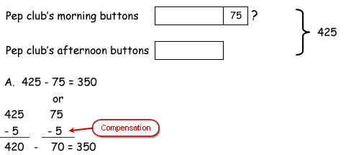
Multistep Problems
The pep club made 425 buttons to sell on Friday. The club sold 75 more buttons in the morning than it did in the afternoon. If all the buttons were sold, how many buttons did the pep club sell in the morning?
2 units = 350, 1 unit = 175
We need morning buttons
175 + 75 = 250
The Pep Club sold 250 buttons in the morning.

Slide 34
Algebraic Steps to a Solution
Let x = number sold in the afternoon then
x+75 = number sold in the morning
x+(x+75) = 425, 2x = 425 - 75
2x = 350, x = 175 so 175+75 = 250 sold in the morning

Slide 35
Subtraction Problems
Most subtraction problems require you to draw a longer unit bar initially
It's really helpful to identify the segment of the unit you're subtracting and draw a diagonal slash through the value. This is a great visual reminder.
We usually place numerical values outside the unit bars with subtraction because we manipulate the inside of the units with sections and slashes.

Slide 36
Ryan and Chris started out with an equal number of baseball cards. Ryan lost 15 cards, and Chris collected another 45 cards. How many more cards did Chris have in the end?
15
Ryan’s baseball cards
Chris’ baseball cards
45
?
So Chris had 15+45 = 60 more cards than Ryan

Slide 37
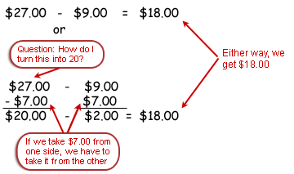
Nathan had $27.00 to buy gifts for his family. If he spent $9.00 on a gift for his brother, how much money did he have left to spend on the rest of his family?
Nathan’s Money
?
$9.00
$27.00

Slide 38
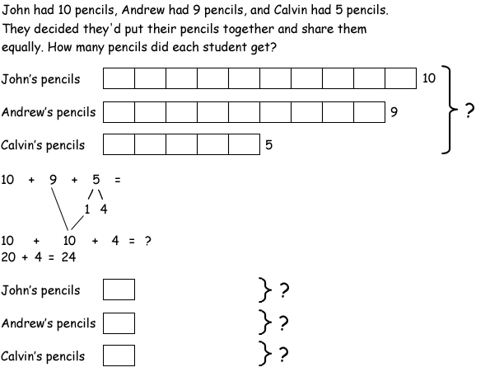
John had 10 pencils, Andrew had 9 pencils, and Calvin had 5 pencils. They decided they'd put their pencils together and share them equally. How many pencils did each student get?

Slide 39
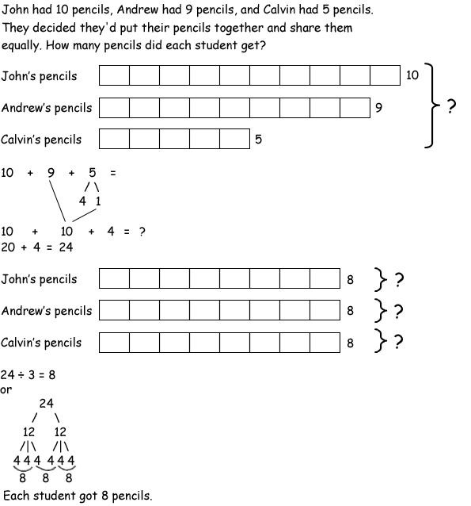

Slide 40
Carlos read 221 pages of his book over the weekend. Jasmine read 198 pages. How many pages did Carlos and Jasmine read altogether?
Carlos’ pages
221
?
Jasmine’s pages
198

Slide 41
A Similar Example
Belvedere's Chocolates made 350 truffles for a wedding. They gave away 46 more truffles at the sign-in table than they did at the dessert buffet. If all the truffles were passed out, how many truffles did Belvedere's give away at the sign-in table?

Slide 43
Snail Pace
One Hour
10 min
Snail A
30 in/hr
5 in
5
5
5
5
5

Slide 44
Snail Pace
One Hour
Snail A
5
5
5
5
5
5
30 in/hr
Snail B
3
3
3
9 in/hr
Snail C
1
1
1
1
4 in/hr
Snail D
3
3
6 in/hr

Slide 45
Another Look at Ivan’s Spending Spree
Ivan went to a store and spent 1/3 of his money on a book. He then went ahead and spent 2/5 of his remaining money on a computer game. After that, he spent 1/4 of his remaining money on a CD. Finally, he spent 1/6 of the remaining money on a candy bar leaving him with $15. How much money did he have originally?

Slide 46
Ivan’s Spending Spree
The bars represent the original amount with the red bar, the amount spent on a book.

Slide 47
2/5 of his remaining money is spent on a computer game

Slide 48
1/4 of his remaining money was spent on a CD

Slide 49
$3
$15
1/6 of his remaining money was spent on a candy bar
leaving him with $15

Slide 50
$6
$18
$15

Slide 51
$8
$8
$24
$18
$15

Slide 52
$60
$20
$40
$24
$18
$15
Ivan started with $60

Slide 53
Consider the fraction remaining rather than the fraction spent
Let x = Ivan’s original amount
x

Slide 54
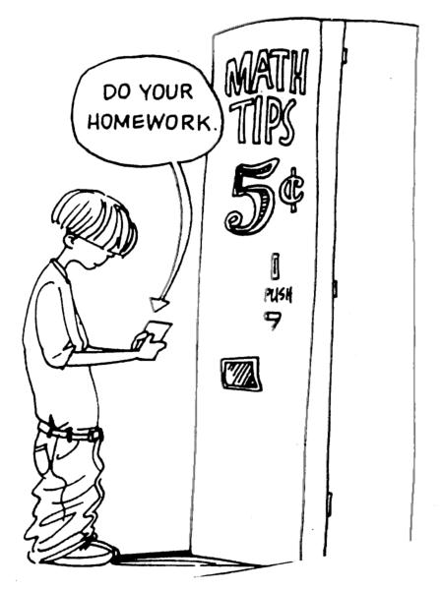

Slide 55
Depth versus Breadth
 | Grade | 1 | Grade | 3 | Grade | 6
Textbook | Number of Lessons | Avg. pages/ lesson | Number of Lessons | Avg. pages/ lesson | Number of Lessons | Avg. pages/ lesson
Singapore | 34 | 15 | 42 | 12 | 24 | 17
Scott-Foresman | 157 | 4 | 164 | 4 | 158 | 5
Everyday Math | 110 | 2 | 120 | 2 | 113 | 4
(Source: American Institute for Research – “What the United States Can Learn From Singapore’s World-Class Mathematics System”)

Slide 56
mastery of basic algorithms is expected in the early grades
The students learn why certain formulas are used rather than just learn how to apply the formulas. Perhaps the most valuable aspect of Singapore Math is that the program encourages active thinking and emphasizes the communication of math ideas. The new common core standards would refer to this process as mathematical reasoning. Our former Ca standards included MR too but in Singapore, the emphasis on MR is much greater as it is in the new Ca version of the common core standards.

Slide 57
Absence of Clutter and Distraction: Presentation is clean and clear and uses simple, concise explanations.
Coherent Development: Topics are introduced with simple examples and then incrementally developed until more difficult problems are addressed.
Teacher and Parent Friendly: Since mathematical content is clear, it is often easier for teachers to plan lessons. Parents can read the books and help children.
Review of concepts is not explicitly incorporated into the curriculum. Students are expected to have mastered a concept once it has been taught.
A high level of expectation is implicit in the curriculum.

Slide 58
Benefits of Model Drawing
Students have one strategy for solving every problem.
Students have a visual to associate with numbers that can be abstract.
Students learn to translate the English into math and then back into English.
Students start to see the relationship behind numerical values.
Notes:
7 steps work for 80% of word problems. Unit bars help visualization. Model drawing builds a bridge between word problems, equations, and solutions. Model drawing emphasizes the relationships between values in the computation.

