Slide 1

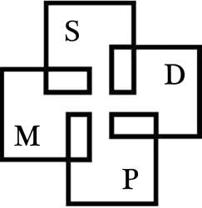

Preparing for Success in Algebra
English Language Learners in Mathematics
A Collaboration between:
Los Angeles USD
University of California, San Diego
San Diego State University
University of California, Irvine

Slide 2
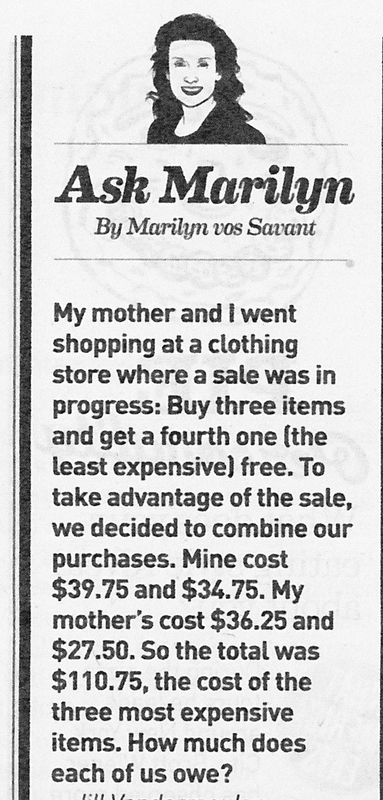
$40.00
$20.00
$30.00
$10.00
$90.00 ,

Slide 4
The distance between Rosa’s house and her school is 3/4 mile. She ran 1/3 of the way to school. How many miles did she run?
Solve the problem in 3 different ways:
Use a bar or ribbon graph model.
Use a number line model.
Use fractional multiplication

Slide 5
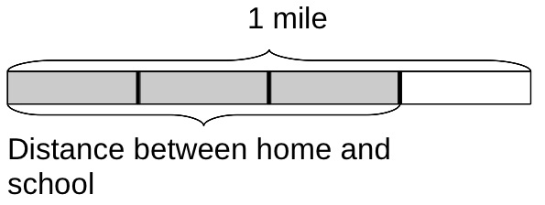
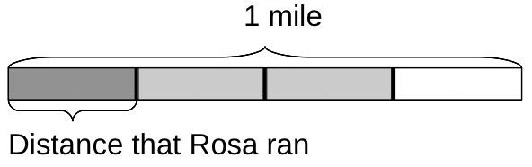
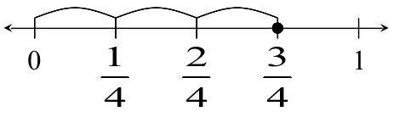
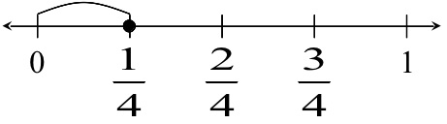
Bar Model
Number Line

Slide 6
The distance between Rosa’s house and her school is 3/4 mile. She ran 1/3 of the way to school. How many miles did she run?
This problem does not require subdivision of the unit fraction, 1/4, in order to find 1/3 of 3/4 since it is naturally composed of 3 pieces. Students readily can solve this problem with a bar graph or number line
model.

Slide 7
The distance between Rosa’s house and her school is 3/4 mile. She ran 1/5 of the way to school. How many miles did she run?
Again solve in 3 different ways using:
A bar or ribbon graph model.
A number line model.
Fractional multiplication

Slide 8
¾ mile
We want the numerator to be divisible by 5 , 3/4 = 3x5/4x5 = 15/20
15/20
3/20
0
3/20
3/4
1

Slide 9
The distance between Rosa’s house and her school is 3/4 mile. She ran 1/5 of the way to school. How many miles did she run?
This task is more complex because it does require students to subdivide the unit fraction used in forming 3/4 in order to find 1/5 of 3/4 .

Slide 10
The distance between Rosa’s house and her school is 1 and 1/2 miles. She ran 1/4 of the way to school. How many miles did she run?
Of course, solve in 3 different ways using:
A bar or ribbon graph model.
A number line model.
Fractional multiplication

Slide 11
We want the numerator to be divisible by 4 , 3/2 = 3x4/2x4 = 12/8
1
1/2
1/4
1/8
1/4 + 1/8 = 3/8 mile
0
3/8
1
1 1/2

Slide 12
The distance between Rosa’s house and her school is 1 and 1/2 miles. She ran 1/4 of the way to school. How many miles did she run?
This third task also requires subdivision but it also involves multiplying a fraction and a mixed number. This has the pitfall that when you divide each half mile and obtain 12 parts, each part is 1/8 and not 1/12.

Slide 13
Apply and extend previous understandings of division to divide unit fractions by whole numbers and whole numbers by unit fractions.
      Interpret division of a unit fraction by a non-zero whole number, and compute such quotients. For example, create a story context for (1/3)÷4 , and use a visual fraction model to show the quotient. Use the relationship between multiplication and division to explain that (1/3)÷4=1/12 because (1/12)×4=1/3 .

Slide 14
Interpret division of a whole number by a unit fraction, and compute such quotients
For example, create a story context for 4÷(1/5) , and use a visual fraction model to show the quotient. Use the relationship between multiplication and division to explain that 4÷(1/5)=20 because 20×(1/5)=4 .

Slide 15
Solve real world problems involving division of unit fractions by non-zero whole numbers and division of whole numbers by unit fractions,
Use visual fraction models and equations to represent the problem. For example, how much chocolate will each person get if 3 people share 1/2 lb of chocolate equally? How many 1/3-cup servings are in 2 cups of raisins?

Slide 16
The students in Ms. Baca’s art class were mixing yellow and blue paint. She told them that two mixtures will be the same shade of green if the blue and yellow paint are in the same ratio. The table below shows the different mixtures of paint that the students made.
 | A | B | C | D | E
Yellow | 1 part | 2 parts | 3 parts | 4 parts | 6 parts
Blue | 2 part | 3 parts | 6 parts | 6 parts | 9 parts
How many different shades of paint did the students make?
Some of the shades of paint were bluer than others. Which mixture(s) were the bluest? Show your work or explain how you know.

Slide 17
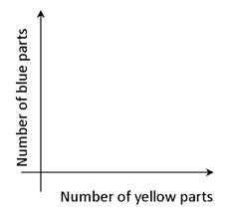
Carefully plot a point for each mixture on a coordinate plane like the one that is shown in the figure. (Graph paper might help.)
Carefully plot a point for each mixture on a coordinate plane like the one that is shown in the figure. (Graph paper might help.)

Slide 18
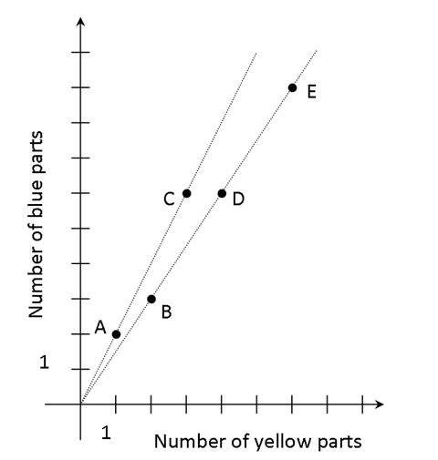
The students made two different shades: mixtures A and C are the same, and mixtures B, D, and E are the same.
To make A and C, you add 2 parts blue to 1 part yellow. To make mixtures B, D, and E, you add 3/2 parts blue to 1 part yellow. Mixtures A and C are the bluest because you add more blue paint to the same amount of yellow paint.
If two mixtures are the same shade, they lie on the same line through the point (0,0).

Slide 19
San Lorenzo Valley Graduation
The SLV High School graduation started at 1:00PM. After some speeches, the principal started reading off the names of the students, alphabetically by last name. When he finishes, the graduation will end.
Estimate when the graduation will end.

